Slide 1
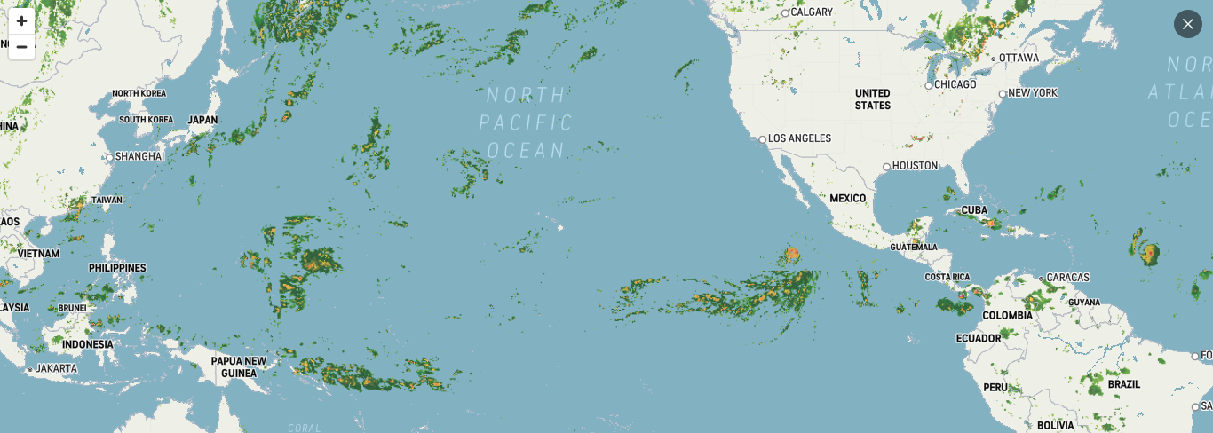
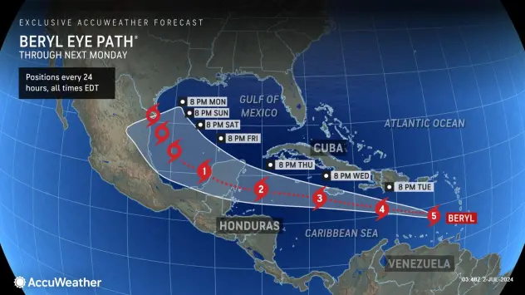
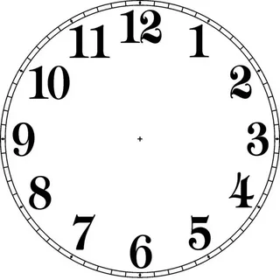
06/15/24
0850H (GMT+8)

Slide 2
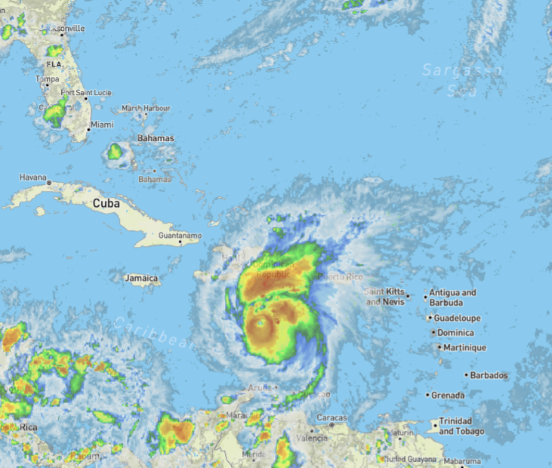

Slide 3
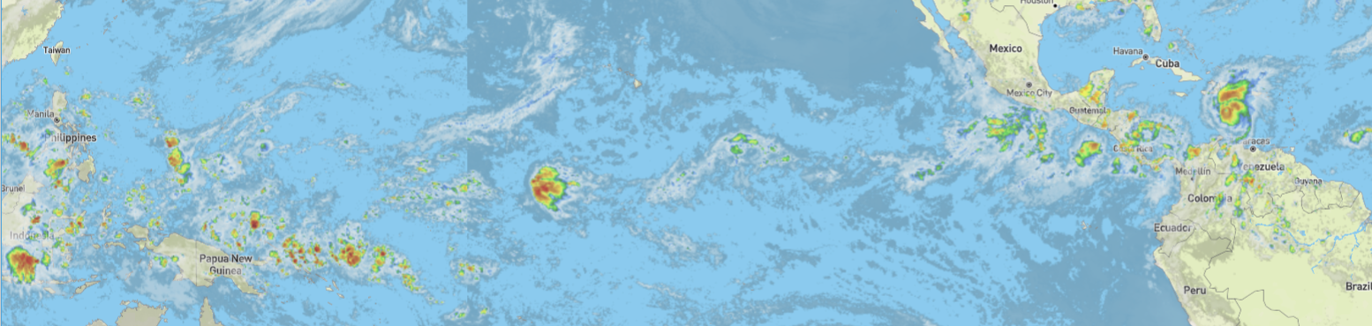

Slide 4
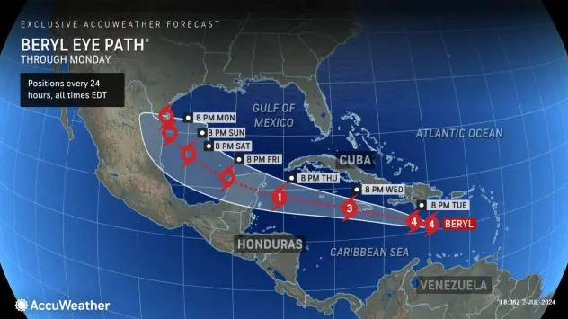

Slide 5
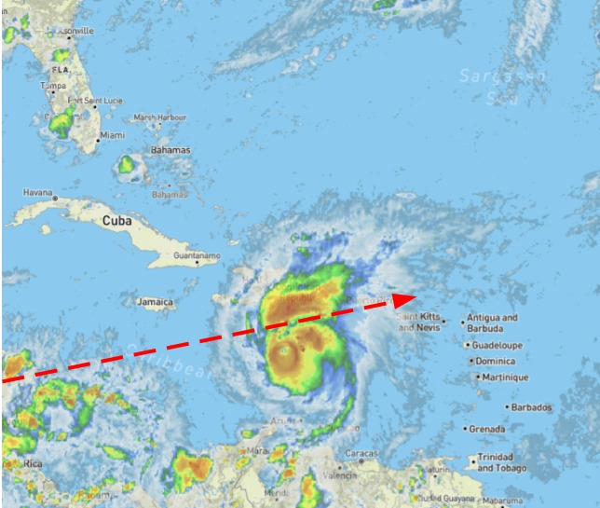
20240703 0549H GMT+8

Slide 6
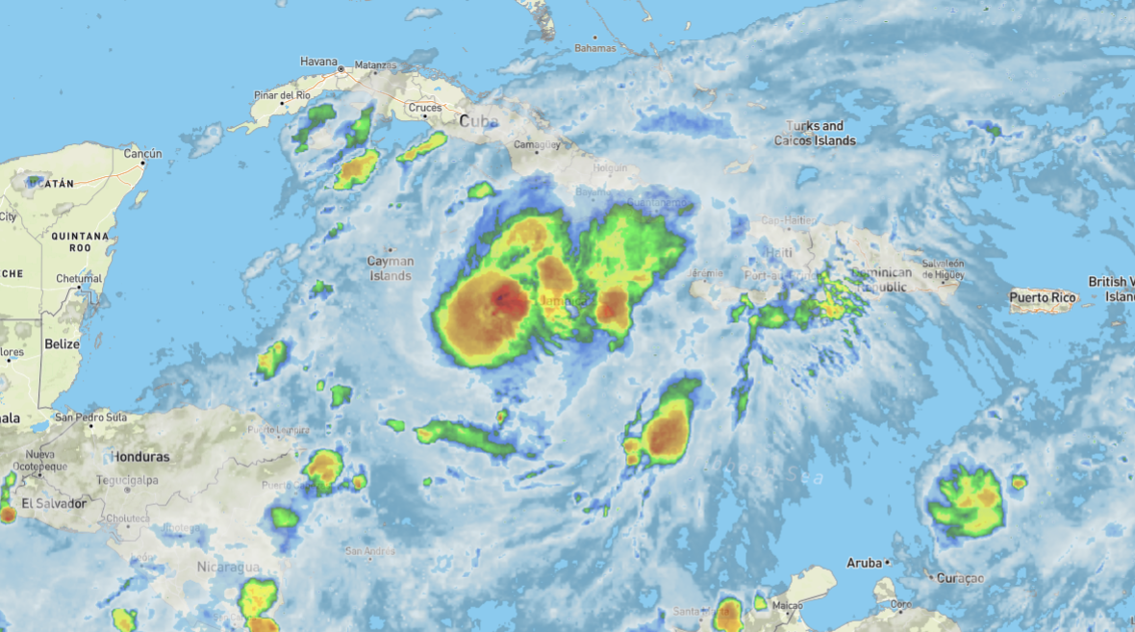
20240704 1032H GMT+8

Slide 7
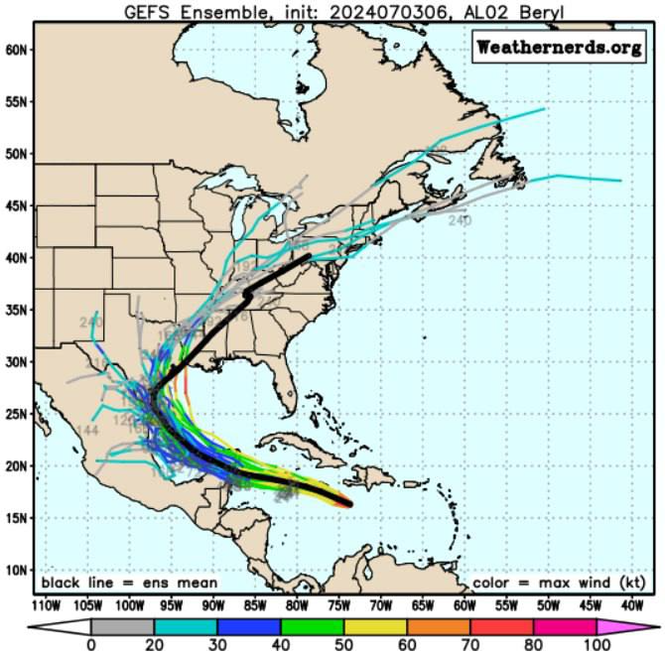
20240704 1157H GMT+8
On Wednesday, Mexico's Meteorological Service posted a hurricane warning for the coast of the Yucatán peninsula from Puerto Costa Maya to Cancún.
After the Yucatán Peninsula, Beryl's forecasted path heads directly to the Texas coast and is expected to move up towards Louisiana. This area is home to major US oil and gas refineries.

Slide 8
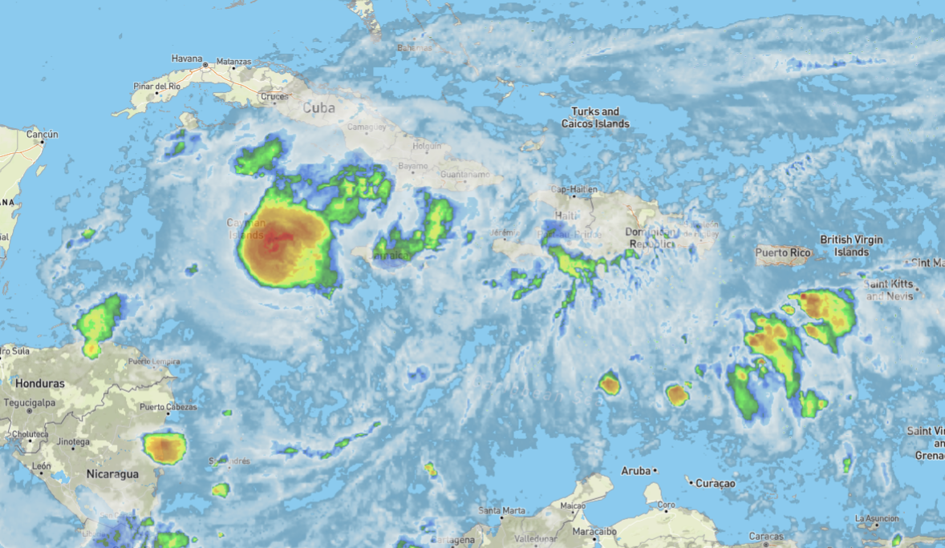
20240704 1607H GMT+8

Slide 9
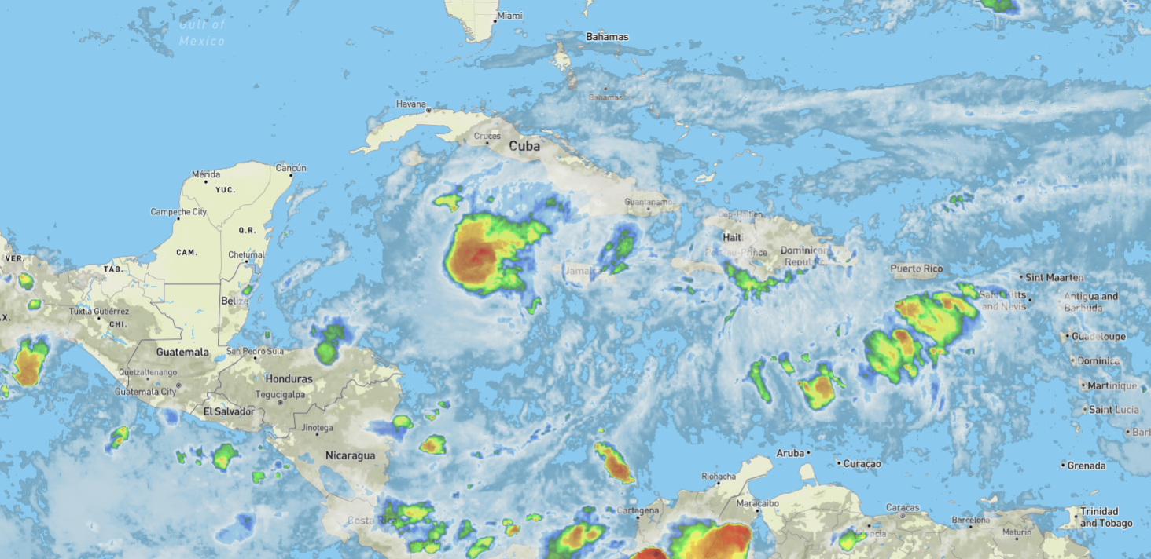
20240704 1807H GMT+8

Slide 10
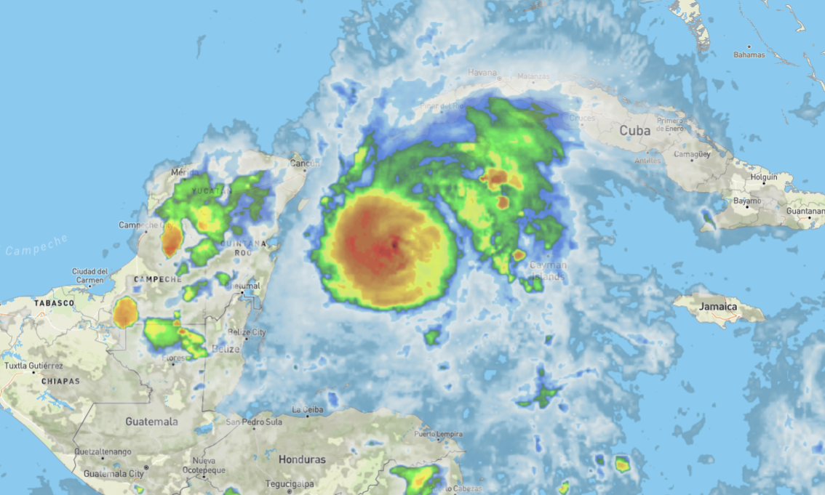
20240705 0802H GMT+8

Slide 11
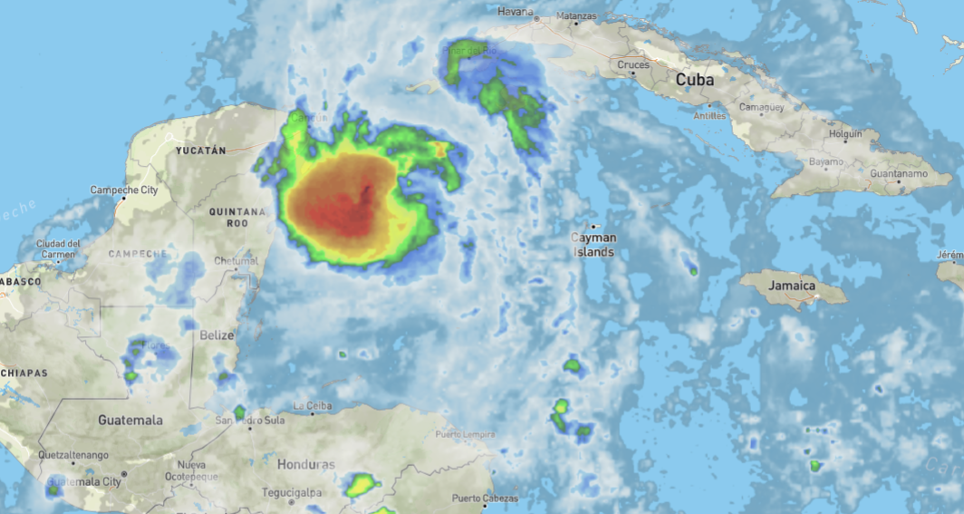
20240705 1303H GMT+8

Slide 12
20240706 0222H GMT+8

Slide 13
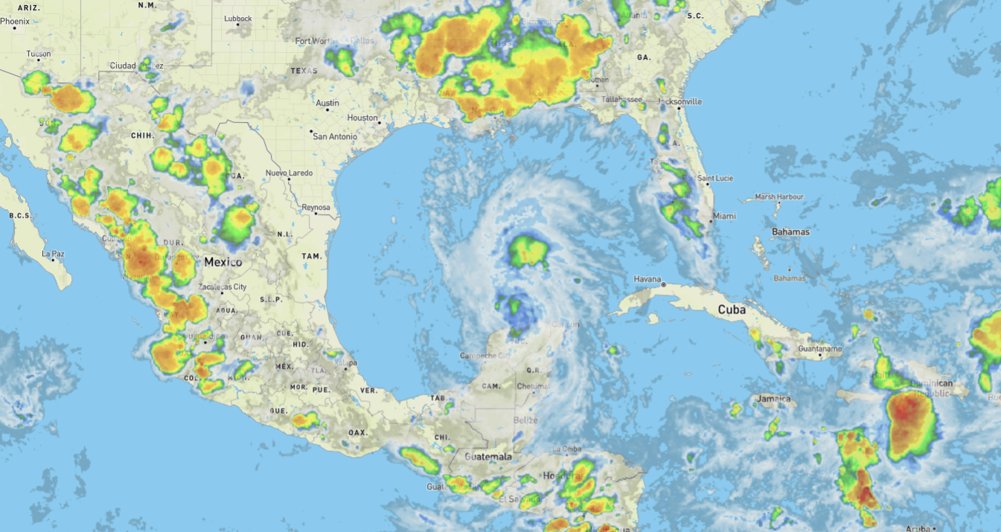
20240706 0845H GMT+8

Slide 14
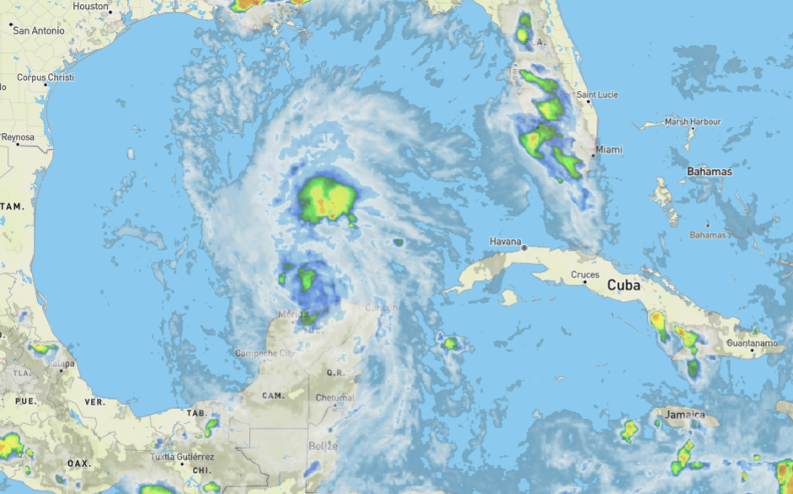
20240706 0845H GMT+8

Slide 15
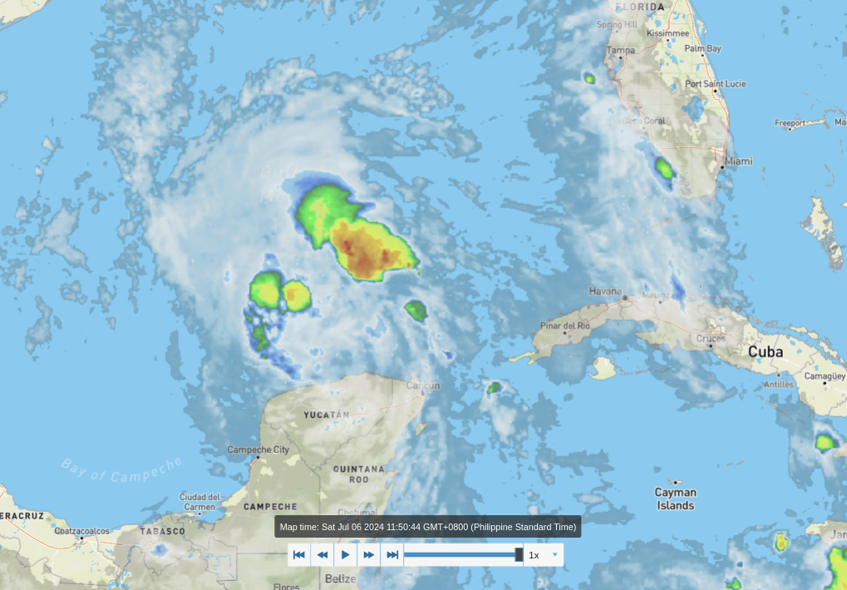
20240706 1152H GMT+8

Slide 16
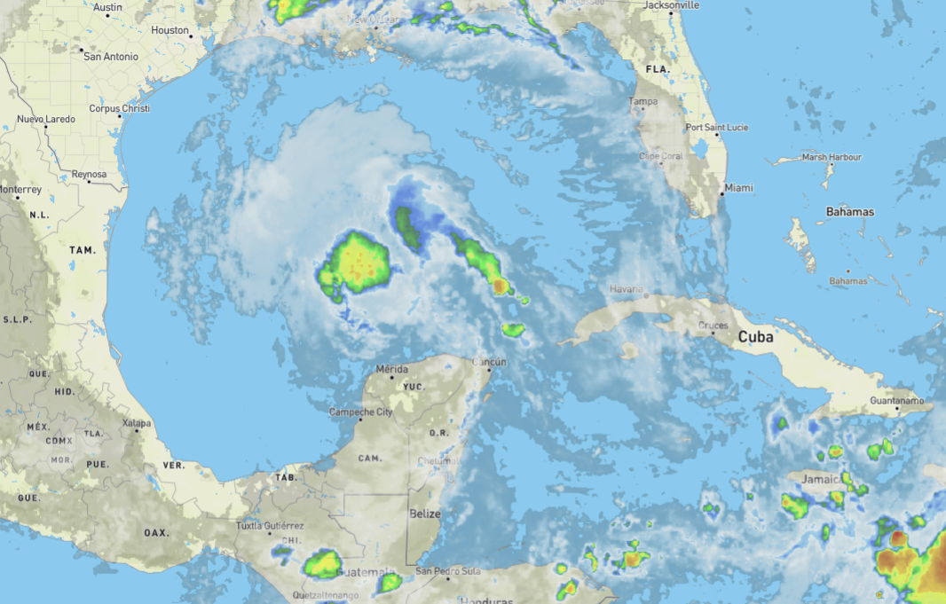
20240706 1437H GMT+8

Slide 17
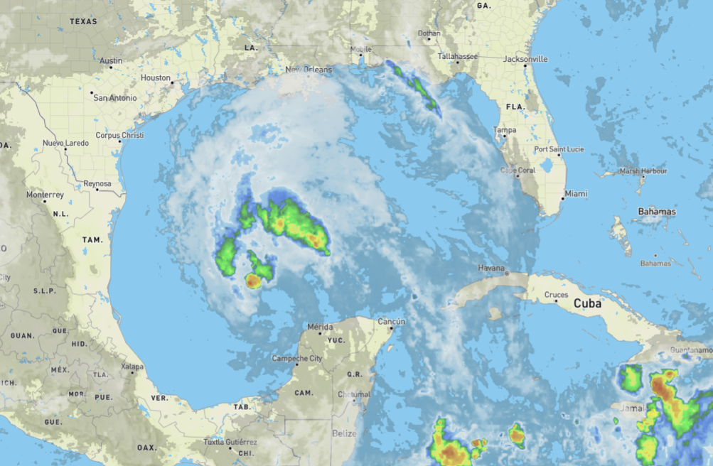
20240706 1437H GMT+8

Slide 18
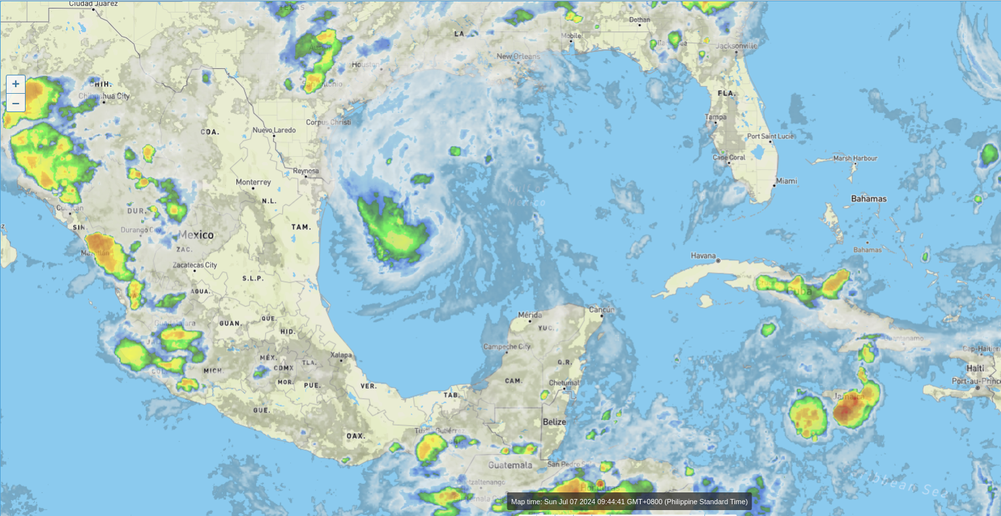
20240707 0936H GMT+8

Slide 19
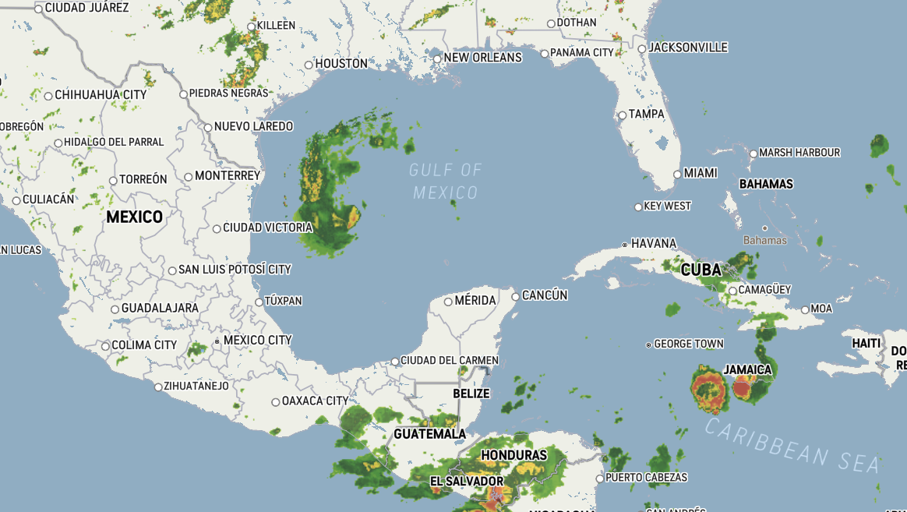
20240707 0936H GMT+8

