Slide 1
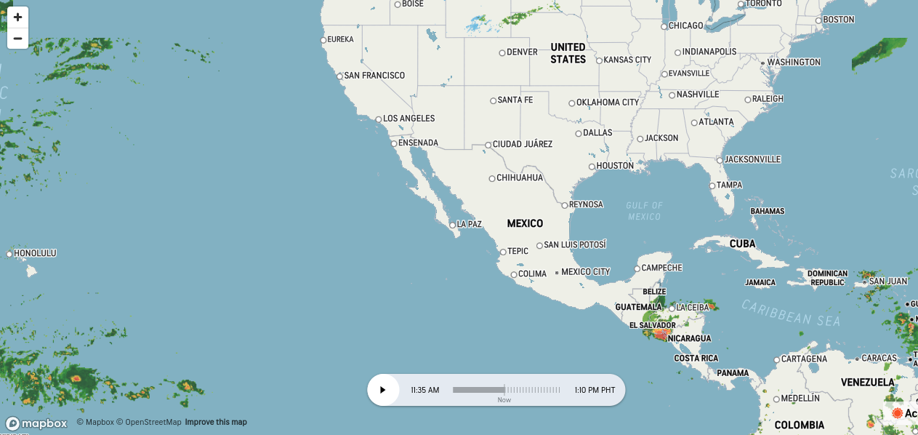
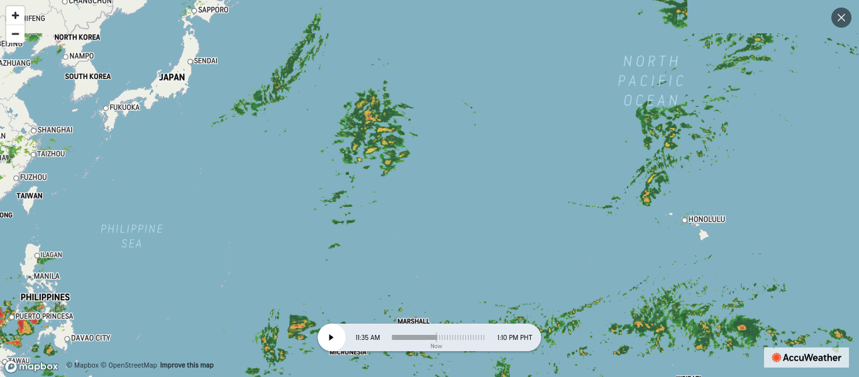
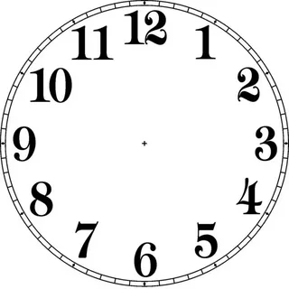

Slide 3
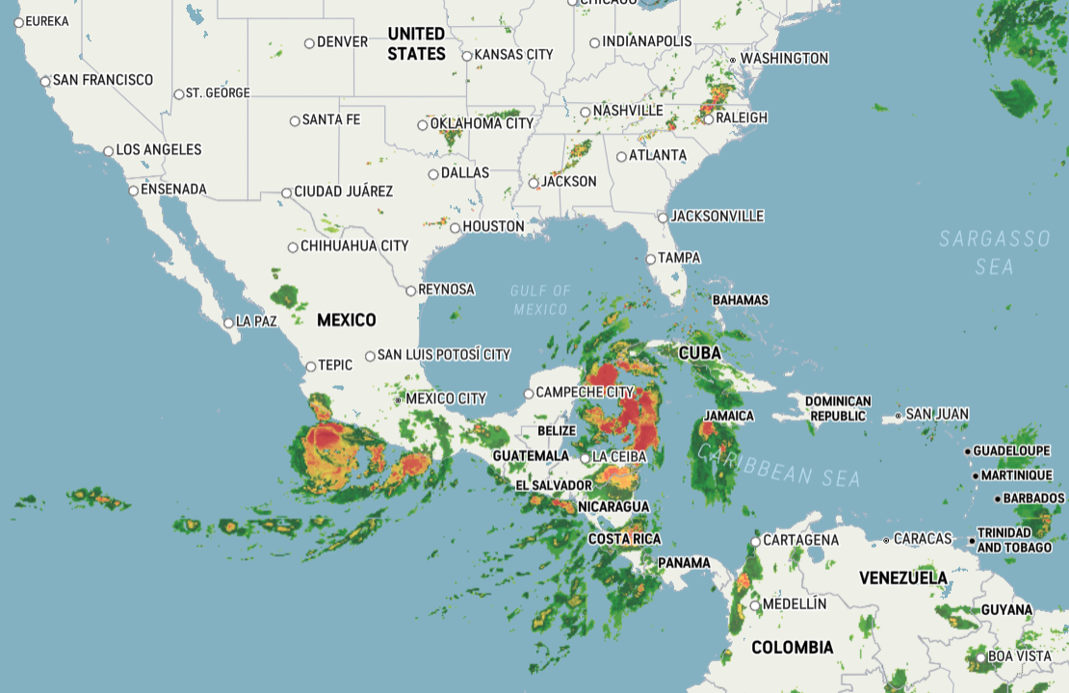

Slide 4
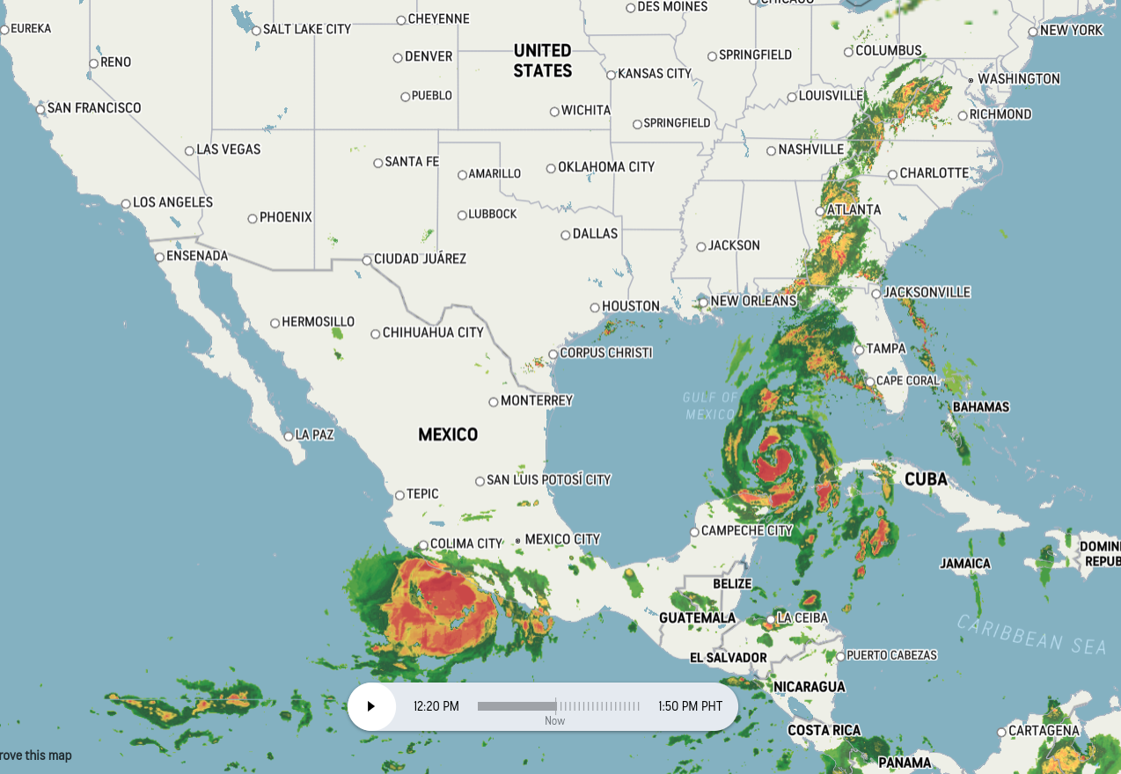
09/26/24 1225H GMT+8

Slide 5
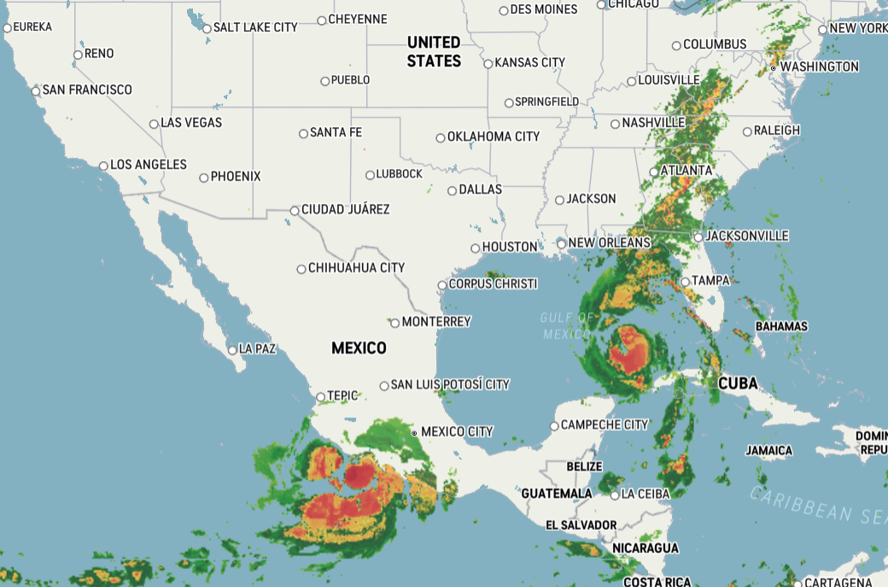
09/26/24 1819H GMT+8

Slide 6
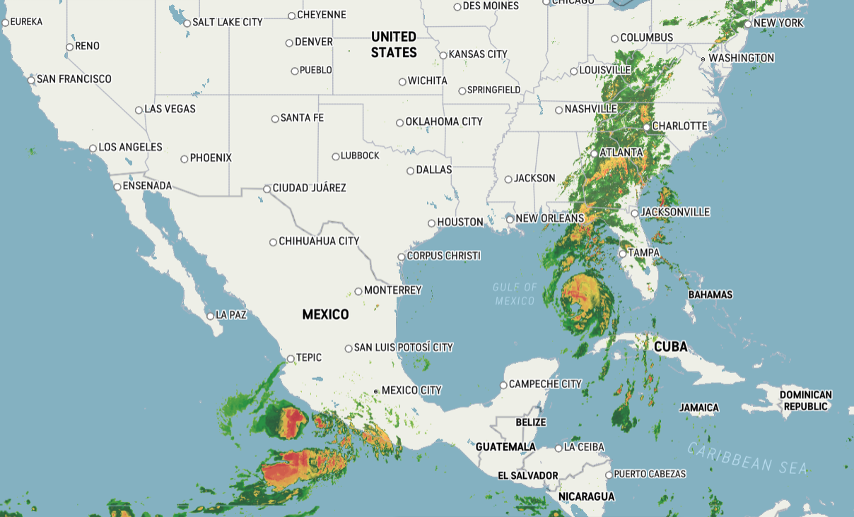
09/26/24 2141H GMT+8

Slide 7
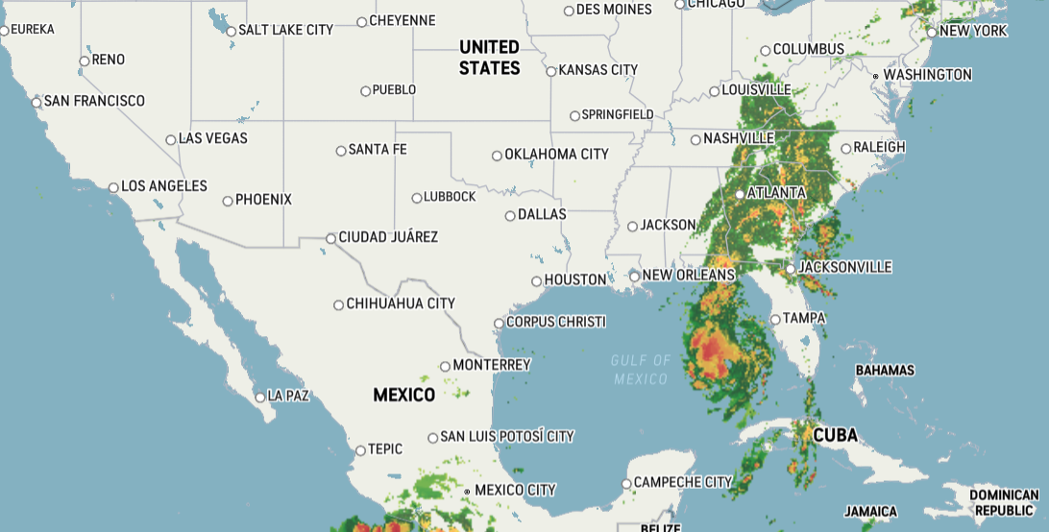
09/27/24 0032H GMT+8

Slide 8
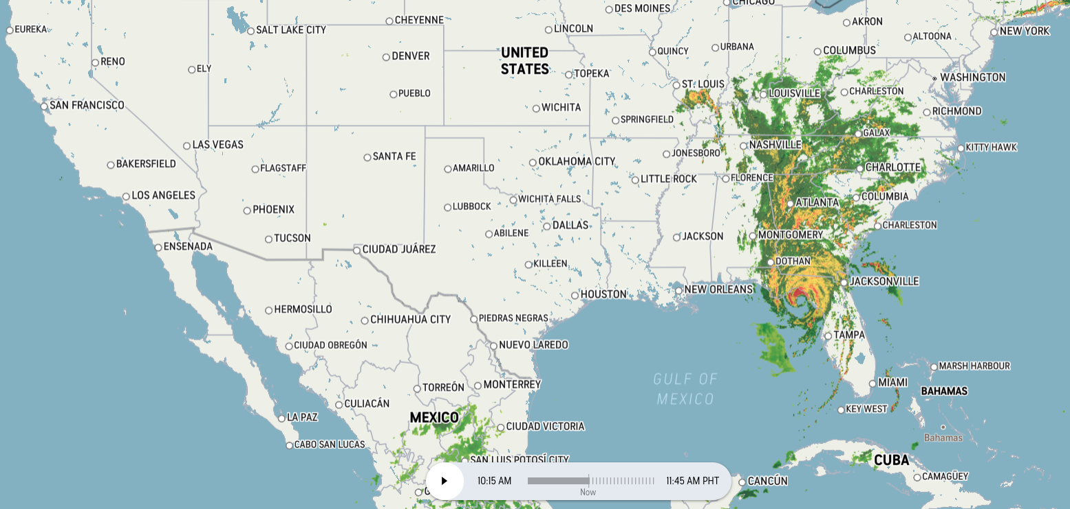
09/27/24 1019H GMT+8

Slide 9
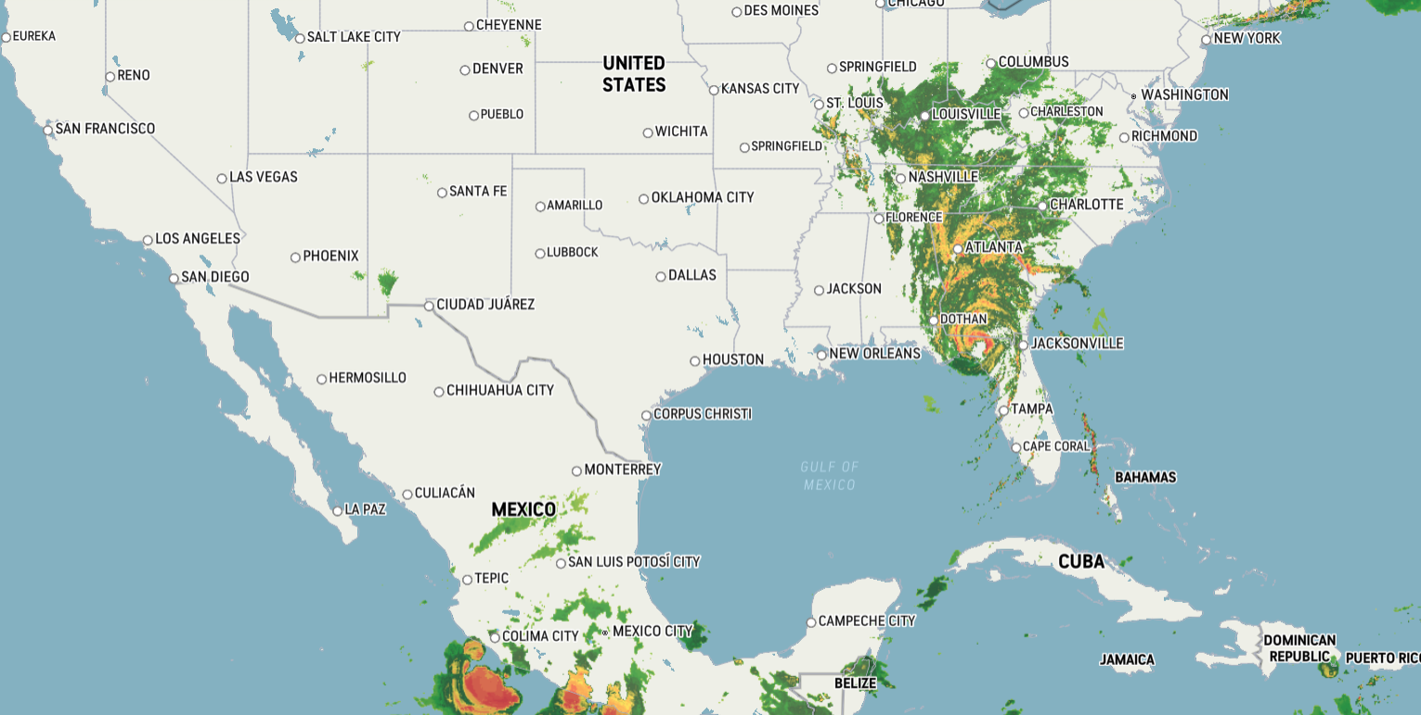
09/27/24 1213h GMT+8

Slide 10
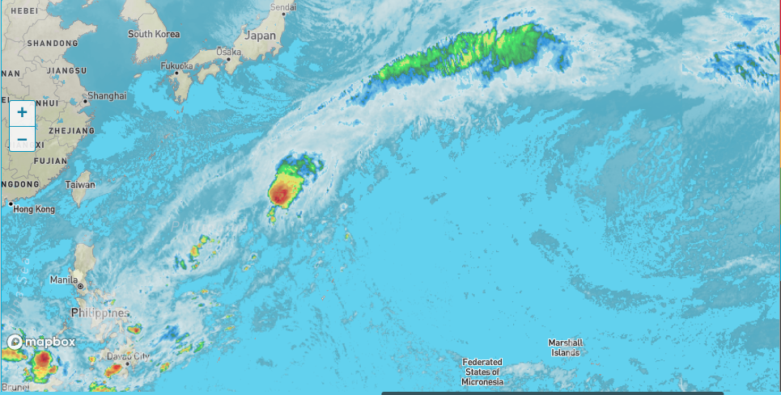

Slide 11
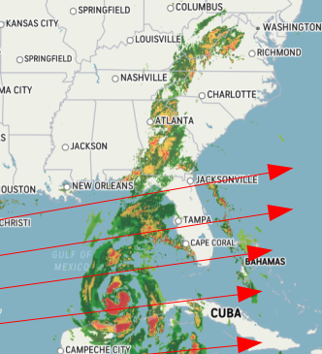
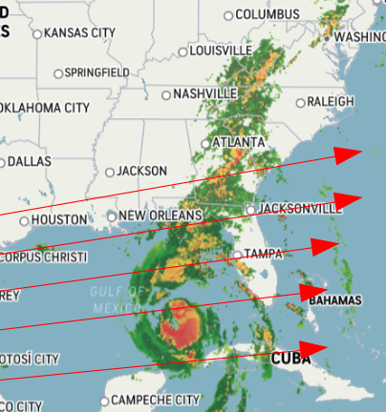
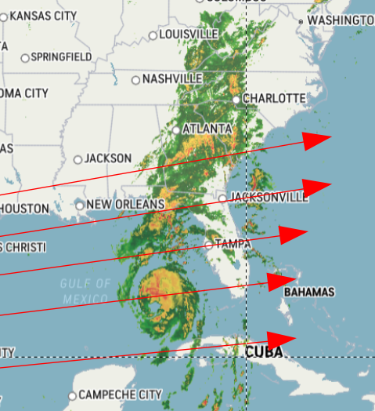
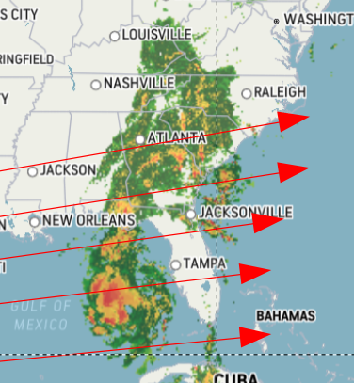
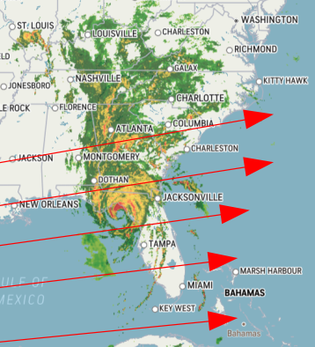
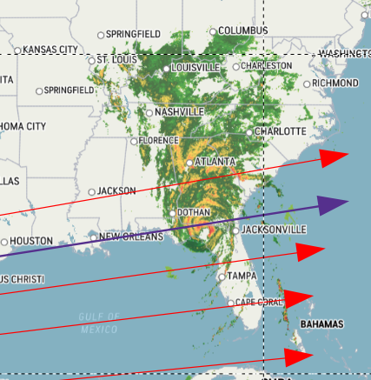
09/26/24 1225H GMT+8
09/26/24 1819H GMT+8
09/26/24 2141H GMT+8
09/27/24 0041H GMT+8
09/27/24 1019H GMT+8
09/27/24 1213H GMT+8
Hurricane Helene
Arrows = path of orgonite pyramid energy

Slide 12
09/27/24 0041H GMT+8
09/27/24 1019H GMT+8
09/27/24 1213H GMT+8

Slide 13
09/27/24 1019H GMT+8
09/27/24 1213H GMT+8

